Slide 1
K-Means Clustering Algorithm
By
Dr. S PADMANABHAN

Slide 2
K-Means Clustering Algorithm
K-Means Clustering is an Unsupervised Learning Algorithm, which groups the unlabeled data into different clusters.
Here K defines the number of pre-defined clusters that need to be created in the process, as if K = 2, there will be two clusters, and for K = 3, there will be three clusters, and so on.

Slide 3
K-Means Clustering Algorithm
It allows us to cluster the data into different groups and a convenient way to discover the categories of groups in the unlabeled dataset on its own without the need for any training.
It is a centroid-based algorithm, where each cluster is associated with a centroid. The main aim of this algorithm is to minimize the sum of distances between the data point and their corresponding clusters.

Slide 4
K-Means Clustering Algorithm
The algorithm takes the unlabeled dataset as input, divides the dataset into k-number of clusters, and repeats the process until it does not find the best clusters. The value of k should be predetermined in this algorithm.
The k-means clustering algorithm mainly performs two tasks:
Determines the best value for K center points or centroids by an iterative process.
Assigns each data point to its closest k-center. Those data points which are near to the particular k-center, create a cluster.

Slide 5
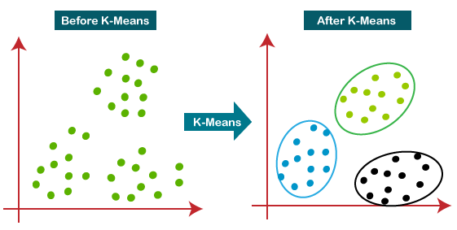
K-Means Clustering Algorithm
Hence each cluster has datapoints with some commonalities, and it is away from other clusters.
The below diagram explains the working of the K-means Clustering Algorithm:

Slide 6
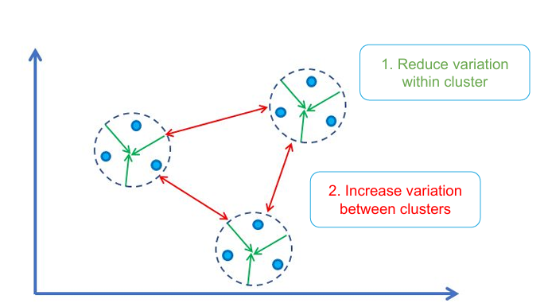
Objective of K-Means Clustering

Slide 7
K-Means Algorithm - Procedure
The steps of the K-Means algorithm are as follows:
Step-1: Choose the number of clusters, K, that we need.
Step-2: Randomly choose K points as cluster centroids. (It can be other from the input dataset).
Step-3: Calculate the distance of each point from cluster centroids.
Step-4: Assign each data point to their closest centroid, which will form the predefined K clusters.
Step-5: Find the new location of the centroid by taking the mean of all the points in each cluster
Step-6: Repeat steps 3-5, until the centroids do not change position

Slide 8
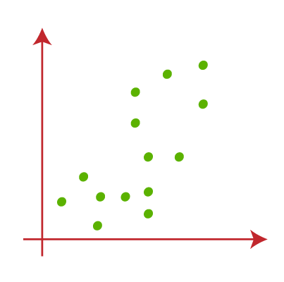
How does the K-Means Algorithm Work?
Let's understand the above steps by considering the following scatter plot:

Slide 9
How does the K-Means Algorithm Work?
Let K = 2, to identify the dataset and to put them into different clusters. It means, we will try to group the dataset into two different clusters.
We need to choose some random k points or centroid to form the cluster. These points can be either the points from the dataset or any other point. So, here we are selecting the below two points as k points, which are not the part of our dataset. Consider the below image:

Slide 10
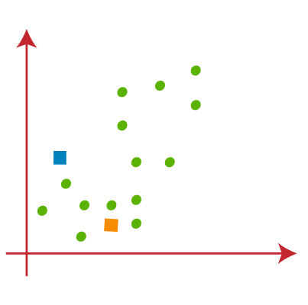
How does the K-Means Algorithm Work?

Slide 11
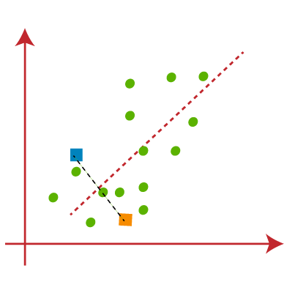
How does the K-Means Algorithm Work?
Now we will assign each data point of the scatter plot to its closest K-point or centroid. We will compute it by applying distance between two points. So, we will draw a median between both the centroids. Consider the image:

Slide 12
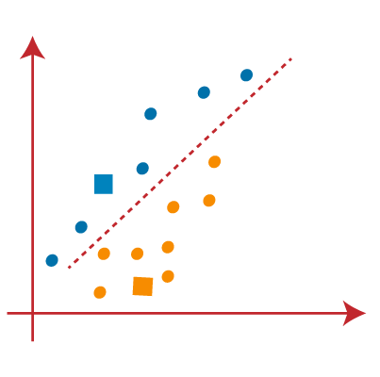
How does the K-Means Algorithm Work?
From the above image, it is clear that points left side of the line is near to the K1 or blue centroid, and points to the right of the line are close to the yellow centroid. Let's color them as blue and yellow for clear visualization.

Slide 13
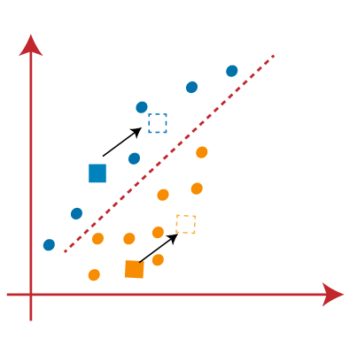
How does the K-Means Algorithm Work?
As we need to find the closest cluster, so we will repeat the process by choosing a new centroid. To choose the new centroids, we will compute the center of gravity of these centroids, and will find new centroids as shown:

Slide 14
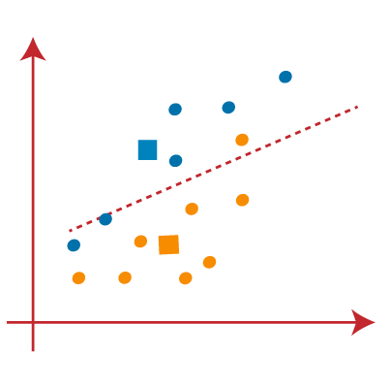
How does the K-Means Algorithm Work?
Next, we will reassign each datapoint to the new centroid. For this, we will repeat the same process of finding a median line. The median will be like below image:

Slide 15
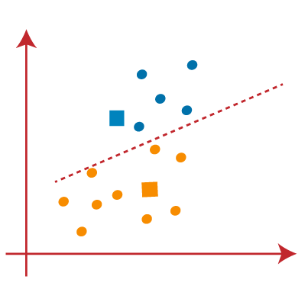
How does the K-Means Algorithm Work?
From the above image, we can see, one yellow point is on the left side of the line, and two blue points are right to the line. So, these three points will be assigned to new centroids.

Slide 16
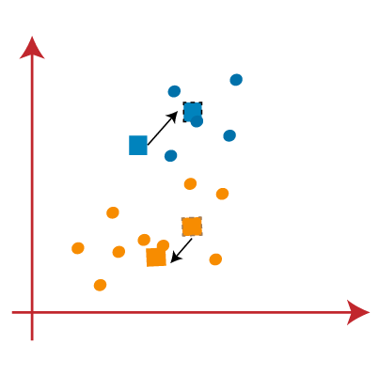
How does the K-Means Algorithm Work?
As reassignment has taken place, so we will again go to the step-4, which is finding new centroids or K-points.
We will repeat the process by finding the center of gravity of centroids, so the new centroids will be as shown in the below image:

Slide 17
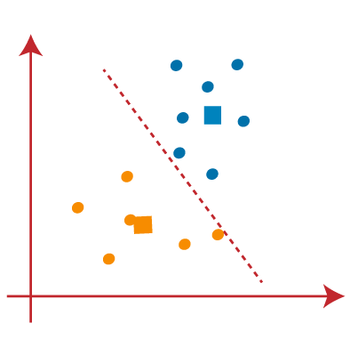
How does the K-Means Algorithm Work?
As we got the new centroids so again will draw the median line and reassign the data points. So, the image will be:

Slide 18
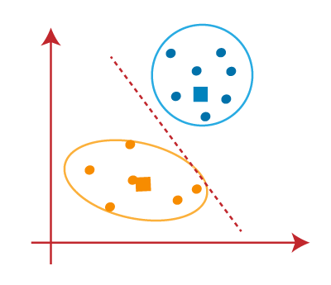
How does the K-Means Algorithm Work?
We can see in the above image; there are no dissimilar data points on either side of the line, which means our model is formed. Consider the below image:

Slide 19
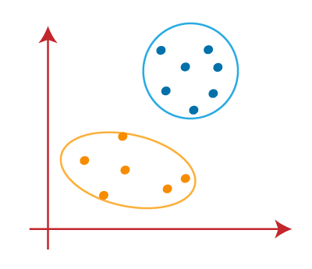
How does the K-Means Algorithm Work?
As our model is ready, so we can now remove the assumed centroids, and the two final clusters will be as shown in the below image:

Slide 20
Applications
K-means is widely used in
market segmentation,
image compression and
pattern recognition.

Slide 21
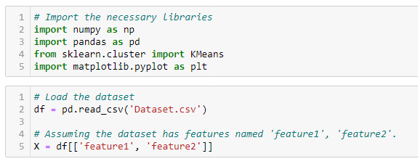
Python Implementation of K-means Clustering Algorithm

Slide 22
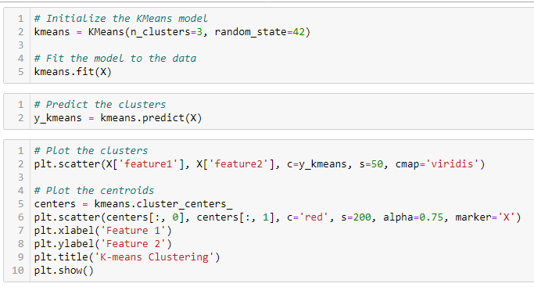

Slide 23
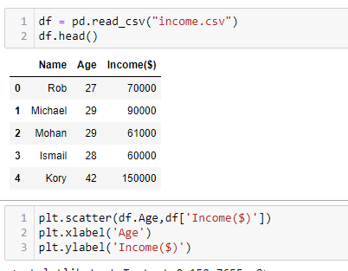
Example

Slide 24
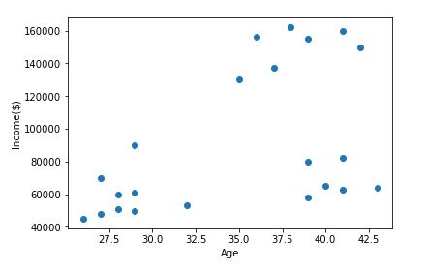

Slide 25
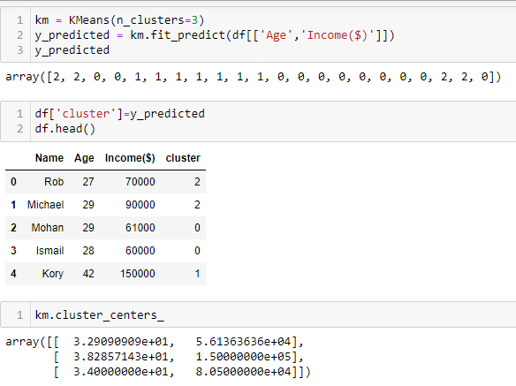

Slide 26
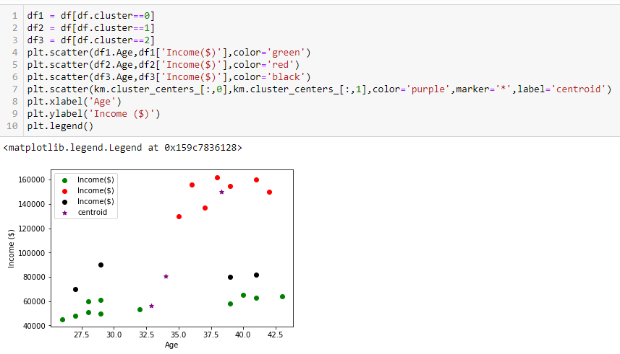

Slide 27
How to choose the value of "K number of clusters" in K-means Clustering?
The performance of the K-means clustering algorithm depends upon highly efficient clusters that it forms. But choosing the optimal number of clusters is a big task. There are some different ways to find the optimal number of clusters, here we study two common techniques to find the optimal value of K.
One of the methods is using the Elbow Plot and the other one is the Silhouette Method

Slide 28
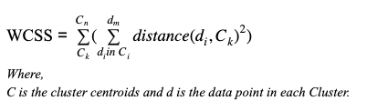
Elbow Method
The Elbow method is one of the most popular ways to find the optimal number of clusters. This method uses the concept of WCSS value.
WCSS stands for Within Cluster Sum of Squares, which defines the total variations within a cluster.
The formula to calculate the value of WCSS is given below:

Slide 29

Elbow Method
The formula to calculate the value of WCSS (for 3 clusters) is given below:
It is the sum of the square of the distances between each data point and its centroid within a cluster.
To measure the distance between data points and centroid, we can use any method such as Euclidean distance or Manhattan distance.

Slide 30
Elbow Method
Lower WCSS values indicate that the data points are closer to their respective centroids, suggesting more compact and well-defined clusters. Conversely, higher WCSS values suggest that the clusters are more spread out and less distinct.
WCSS is often used in the Elbow Method to determine the optimal number of clusters. By plotting WCSS against the number of clusters, you can identify the “elbow point” where the rate of decrease sharply slows down. This point indicates a balance between having too few clusters (high WCSS) and too many clusters (overfitting).

Slide 31
To find the optimal value of clusters, the elbow method follows the below steps:
It executes the K-means clustering on a given dataset for different K values (ranges from 1-10).
For each value of K, calculates the WCSS value.
Plots a curve between calculated WCSS values and the number of clusters K.
The sharp point of bend or a point of the plot looks like an arm, then that point is considered as the best value of K.

Slide 32
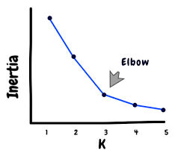

Slide 33
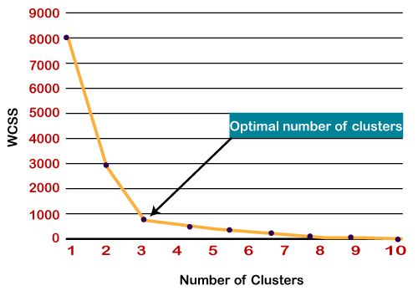

Slide 34
Problem: The points in the cluster1 at the final iteration are (2, 4), (3, 4), (1, 3) and (2, 5). Compute the cluster inertia.
Cluster inertia, also known as within-cluster sum of squares (WCSS), is a measure of how tightly the points in a cluster are grouped around the centroid. It is calculated as the sum of the squared distances between each point in the cluster and the cluster centroid.
Steps to Calculate Cluster Inertia
Calculate the Centroid of the Cluster:
Given points: (2,4), (3,4), (1, 3), (2,5)
The centroid (xˉ, yˉ ​) of the cluster is the mean of the coordinates of the points.
xˉ = (2 + 3 + 1 + 2) / 4 = 8 / 4 = 2
yˉ= (4 + 4 + 3 + 5) / 4 = 16 / 4 = 4
So, the centroid is (2,4)

Slide 35
Calculate the Squared Distance of Each Point to the Centroid:
Point (2,4): d² = (2 - 2)² + (4 - 4)² = 0
Point (3,4): d² = (3 - 2)² + (4 - 4)² = 1
Point (1,3): d² = (1 - 2)² + (3 - 4)² = 2
Point (2,5): d² = (2 - 2)² + (5 - 4)² = 1
Sum the Squared Distances:
Cluster Inertia = 0 + 1 + 2 + 1 = 4
Conclusion: The cluster inertia for the points (2,4), (3,4), (1,3) and (2,5) is 4.

Slide 36
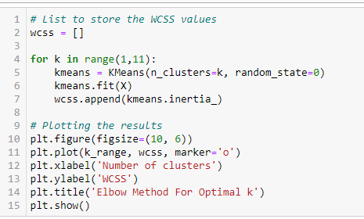
Python code

Slide 37
Silhouette Method
The Silhouette Score is a metric used to evaluate the quality of clusters in clustering algorithms.
Silhouette score is used to find the optimal number of clusters.
The Silhouette Score measures how similar an object is to its own cluster (cohesion) compared to other clusters (separation). It ranges from -1 to +1
A score close to +1 indicates that the data point is well matched to its own cluster and poorly matched to neighboring clusters.
A score close to 0 indicates that the data point is on or very close to the decision boundary between two neighboring clusters.
A score close to -1 indicates that the data point might have been assigned to the wrong cluster.

Slide 38
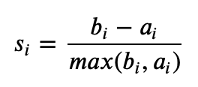
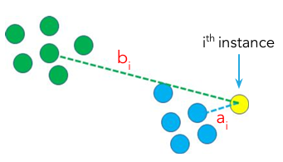
Silhouette coefficient
Silhouette Score for a datapoint i is given as
Where:
s(i) is the silhouette score for data point i,
a(i) is the average distance from the ith data point to the other data points in the same cluster (cohesion),
b(i) is the smallest average distance from the i-th data point to data points in a different closest cluster (separation).

Slide 39
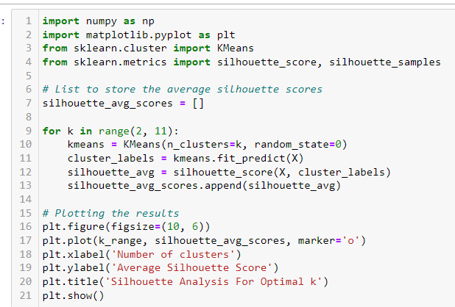
Python code
The silhouette_score function provides an average Silhouette Score for the entire dataset,
silhouette_samples gives
the Silhouette Score for each data point. This allows for a more detailed analysis of how well each point fits within its cluster.

Slide 40

Python code

Slide 41
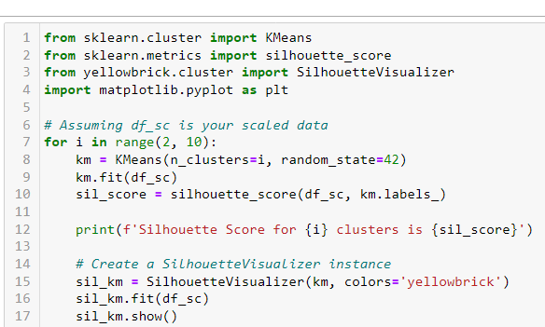
Python code
The following code will calculate and print the Silhouette Score for each number of clusters from 2 to 9 and display the corresponding silhouette plots.

Slide 42
Difference between using Elbow method and Silhouette method
Elbow Method: Focuses on minimizing the WCSS and provides a visual way to determine the optimal ( k ). It is simpler but can be ambiguous.
Silhouette Method: Focuses on maximizing the average Silhouette Score, providing a more detailed measure of cluster quality. It is more computationally intensive but often gives a clearer indication of the optimal ( k ).

Slide 43
Feature | Elbow Method | Silhouette Method
Objective | Minimizes within-cluster variance (WCSS) | Maximizes the average silhouette score
Evaluation Criterion | Measures how WCSS decreases as k increases | Measures how well-separated clusters are (cohesion vs. separation)
Interpretation | Look for the "elbow" where WCSS stops decreasing rapidly | Find the k with the highest silhouette score
Ease of Use | Simple to implement and interpret | Requires more calculation but provides more insights
Visualization | Elbow point on a WCSS vs. k graph | Maximum silhouette score on a silhouette score vs. k graph
Subjectivity | Subjective interpretation of the elbow point | More objective with a clear score for each k
Cluster Shape Sensitivity | May not perform well with non-spherical clusters | Works well with clusters of different shapes and densities

Slide 44
When to Use:
Elbow Method: Use when you need a simple and fast method to estimate k, especially for spherical clusters.
Silhouette Method: Use when you want a more robust evaluation of clustering quality, particularly when clusters have varying shapes and densities.

